Slide 1
Unit 7: Data Communication and Computer Network
Prepared by: Natabar Khatri New Summit College

Slide 2
Data Transmission across Media
Data Transmission:
Involves sending bits (0s and 1s) through a physical path (called transmission media).
Data is converted into electrical signals (traditional cables) or light signals (fiber optics) for transmission. Before transmission, data might be encoded and sent as characters.

Slide 3
Data Transmission across Media
Communication Modes:
Communication between devices can be:
Simplex: One-way communication (e.g., a keyboard sending data to a computer).
Half-duplex: Two-way communication, but only one device can transmit at a time (e.g., a walkie-talkie).
Full-duplex: Two-way communication where both devices can transmit and receive simultaneously (e.g., a telephone conversation).

Slide 4
Data Transmission Speed
two key factors influence the speed and success of the transmission: bandwidth and distance.
Bandwidth:
Represents the amount of data transferable through a medium (cable/wire) in a specific time.
It's measured in bits per second (bps), typically Mbps (megabits per second) or Gbps (gigabits per second) for larger connections.
Throughput:
Actual amount of data successfully transmitted between devices, measured in bits per second (bps).
Upper limit is set by the bandwidth of the communication medium.

Slide 5
Broadband vs. Baseband:
Broadband technology utilizes a larger portion of the electromagnetic spectrum for higher throughput.
Baseband technology uses a smaller portion, resulting in lower throughput.
Distance Impact:
Throughput is affected by the distance between connected devices, even with a specific bandwidth. Distortion caused by internal/external factors can further impact throughput.
Cable Examples:
Cat-5 UTP cable: 100 Mbps throughput over 100 meters.
10BASE2 Coaxial cable: Up to 10 Mbps throughput over 185 meters.
10BASE5 Coaxial cable: Up to 10 Mbps throughput over 500 meters (longest reach).

Slide 6
Modulation and demodulation
Communication systems use two types of signals:
Information signal (message signal): This carries the actual information you want to transmit, like your voice in a phone call or digital data for an image. This signal is usually a lower frequency than the carrier wave.
Carrier signal: This is a high-frequency wave that can travel long distances effectively. It acts as a "carrier" for the information signal.

Slide 7
Modulation and demodulation
Modulation process: Modulation combines the information signal with the carrier signal by varying the carrier's characteristics (amplitude, frequency, or phase) based on the information signal. This creates a new modulated carrier wave that "rides" on the carrier and carries the information from the message signal.
Need for Modulation:
There are three main reasons why we modulate signals for communication:
Efficient transmission over long distances
To allow Multiplexing of the signals
Improved antenna efficiency

Slide 8
Types of Modulation:
Three main types of modulation:
Amplitude Modulation (AM): In AM, the amplitude (strength) of the carrier signal is varied according to the information signal.
Frequency Modulation (FM): In FM, the frequency of the carrier signal is varied according to the information signal.
Phase Modulation (PM): In PM, the phase of the carrier signal is varied according to the information signal.

Slide 9
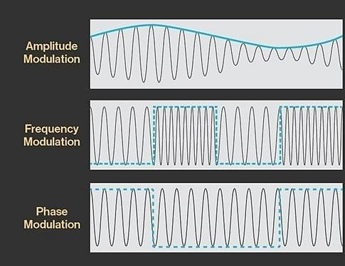
Types of Modulation

Slide 10
Demodulation:
Demodulation is the reverse process of modulation.
Demodulation is the process of recovering the original information signal from the modulated carrier wave at the receiving end.
The demodulator circuit separates the information signal by exploiting the way the carrier signal was altered during modulation (e.g., demodulating the changes in amplitude for AM)
Demodulation is used in a wide range of applications, from radio broadcasting to wireless communication and satellite systems.

Slide 11
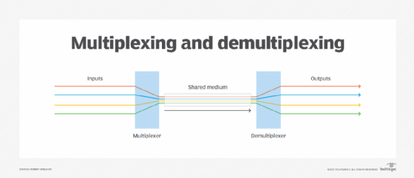
Multiplexing and demultiplexing
Multiplexing
Multiplexing combines multiple signals into a single form for transmission on a single link.
Demultiplexing
Demultiplexing separates the combined signals at the receiving end and directs them to their destinations.

Slide 12
Multiplexing and demultiplexing
Types of Multiplexing:
Frequency Division Multiplexing (FDM):
Combines signals of different carrier frequencies into one higher bandwidth signal.
Used in high-bandwidth analog transmission systems like broadband technology.
Wavelength Division Multiplexing (WDM):
Similar to FDM but uses light signals instead of radio frequencies.
Combines multiple light signals from different sources into a single, larger bandwidth signal on a single fiber optic cable.
Enables bi-directional communication on a single fiber.

Slide 13
Asynchronous and Synchronous Transmission
Synchronization Challenge in Data Transmission:
Data transmission requires the sender and receiver to be in sync for accurate data interpretation.
The receiver needs to identify the start and end of individual data units (bits and bytes) within the incoming signal.
Two Approaches to Synchronization:
Synchronous Transmission
Asynchronous Transmission

Slide 14
Asynchronous and Synchronous Transmission
Synchronous Transmission
Asynchronous Transmission
Sender and receiver coordinate before data transfer.
Maintains a constant transmission rate unaffected by network traffic.
Example: Used in voice communication systems.
No pre-coordination needed between sender and receiver.
Receiver is always ready to accept data whenever it arrives.
Sender transmits data as it becomes available.
Example: Used in most data networks and RS-232 serial devices.

Slide 15
Data Transmission and Data networking
Data Transmission
Data Transmission is the process of sending data from one device to another over a communication channel.
It primarily concerned with the physical movement of data from a source to a destination.
Data Networking
Data Networking is the process of connecting multiple devices to share resources and communicate with each other using a set of rules (protocols).
It is concerned with the logical and organizational aspects of data communication, including how devices are connected, how data is routed, and how resources are shared.

Slide 16
Data Transmission and Data networking
Point-to-Point vs. Networks:
Point-to-Point:
Directly connects two devices for dedicated communication
Uses simpler protocols such as PPP (Point-to-Point Protocol), HDLC (High-Level Data Link Control)
Simple and straightforward, with no intermediate devices (in most cases).
Commonly used in scenarios where a secure, private, or high-speed connection is required.
Examples:
Serial communication between two computers.
A direct cable connection (e.g., USB or Ethernet).
Dial-up connections between a computer and a modem.
Point-to-Point Protocol (PPP) used in DSL or VPN connections.
Networks: Use nodes to share a communication medium (more efficient and cost-effective).

Slide 17
Data Transmission and Data networking
Networks:
Uses a system of interconnected devices (nodes) to share a communication medium (more efficient and cost-effective).
Requires protocols and addressing mechanisms (e.g., IP addresses) to manage communication.
Can be local (LAN) or wide-area (WAN), depending on the scale..
Examples:
Local Area Network (LAN) in an office or home
The Internet and most cloud-based networks.
Wireless networks (Wi-Fi)

Slide 18
Data Transmission and Data networking
Network Interface
Hides the physical transmission details and allows sending data in larger chunks (bytes) instead of individual bits.
A Network Interface is the point of interconnection between a device and a network.
It can be a hardware component (e.g., a Network Interface Card or NIC) or a software component (e.g., a virtual network interface).
Each network interface is associated with a unique identifier, such as a MAC address (Media Access Control address) for hardware interfaces or an IP address for logical interfaces.

Slide 19
Data Transmission and Data networking
In and uncontrolled Access all devices could access the network anytime, leading to congestion.
Switching: Introduced controlled access using temporary connections between nodes, enabling fair sharing of the medium.
Packet Switching: Most common, breaks data into packets and sends them independently.
Circuit Switching: Less common, creates a dedicated connection between two devices for the entire transmission.
Message Switching: Not used in modern networks, stores and forwards entire messages.

Slide 20
Data Transmission and Data networking
Circuit Switching:
Creates a dedicated connection between sender and receiver before data transmission.
The path gets reserved during the duration of the connection.
Similar to a phone call where a dedicated line is established for the conversation.
Commonly used in traditional phone networks.

Slide 21
Data Transmission and Data networking
Message Switching:
No dedicated path: Message switching doesn't create a direct connection between sender and receiver.
Store and forward: Messages are stored at intermediate nodes until a free route to the next node is available.
High storage requirements: Nodes need large memory to store messages before forwarding.
Delays: Storing and forwarding messages introduces delays in communication.
Not for real-time: Delays make message switching unsuitable for interactive applications.
Obsolete in networks: Message switching is rarely used in modern computer networks due to its limitations.

Slide 22
Data Transmission and Data networking
Packet Switching:
Breaks messages into smaller, numbered packets for transmission.
No dedicated path reserved; packets can take different routes.
Packets contain data and addressing information for reassembly at the destination.
Efficient for interactive traffic due to smaller packet size and reduced delays.
No dedicated links needed, shares network resources efficiently.
Commonly used in computer networks like the internet.

Slide 23
Computer Network
Network Topologies/LAN Topologies
A network topology refers to the geometric layout of how devices are interconnected in a network
There are different types of network topologies that are used in a network.
Commonly used in LAN are:
Bus Topology
Star Topology
Ring Topology

Slide 24
Computer Network
Bus Topology
Features: All devices are connected to a single central cable, the backbone. Requires terminators at each end to prevent signal bounce.
Advantages:
Simple and inexpensive to set up.
Easy to install and expand new devices.
Disadvantages:
A single cable failure disrupts the entire network.
Performance degrades as more devices are added due to signal collisions.
Troubleshooting can be difficult due to shared cable.

Slide 25
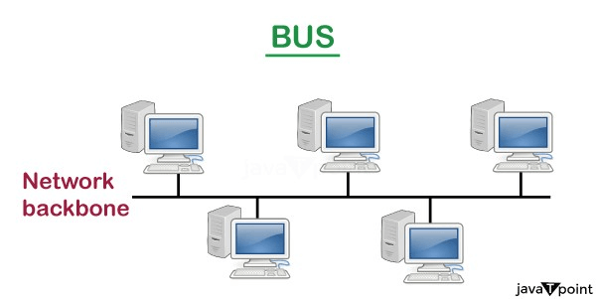
Computer Network
Bus Topology

Slide 26
Computer Network
Ring Topology
Features: Devices are connected in a closed loop, forming a ring. Each device acts as a repeater, receiving and retransmitting signals.
Advantages:
Ordered data flow avoids collisions seen in bus topology.
Relatively easy to expand the network.
Disadvantages:
A single device failure disrupts the entire network.
Adding or removing devices requires taking down the network.
Troubleshooting can be complex due to the closed loop.

Slide 27
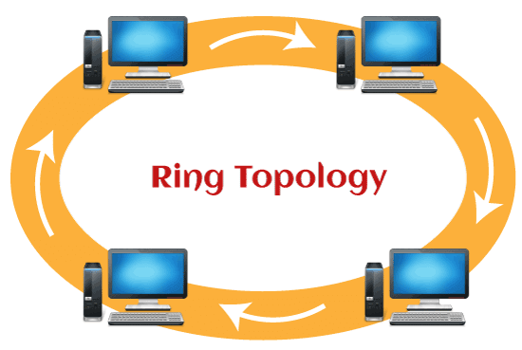
Computer Network
Ring Topology

Slide 28
Computer Network
Star Topology
Features: Devices are connected individually to a central hub or switch. The central device manages data flow and communication.
Advantages:
Most reliable: Failure of one device doesn't affect others.
Easier to troubleshoot and isolate problems.
Scalable: New devices can be added easily without affecting the network.
Disadvantages:
More expensive to set up due to additional cabling required.
Relies on the central device, which can be a single point of failure if it malfunctions.

Slide 29
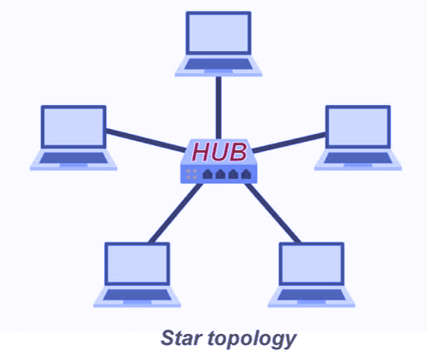
Computer Network
Star Topology

Slide 30
Communication Protocol
Protocol is a network term used to indicate the set of rules used by a network for communication.
The application programs that use the network do not interact with the hardware directly. The application programs interact with the protocol software, which follows the rules of the protocol while communicating.
The network communication protocol is organized as a stack of layers with one layer built upon the other. Each layer has a specific function and interacts with the layers above and below it.

Slide 31
The OSI Model
Open System Interconnection (OSI) model is a conceptual framework developed by the International Organization for Standardization (ISO) to define how network communication protocols should be structured.
It devides network communication into seven layers, each with specific functions.
OSI model does not specify how the protocol needs to be implemented. It is independent of the underlying architecture of the system and is thus an open system.

Slide 32
THE Osi model

Slide 33
The OSI Model
The top three layers of the OSI model deal with application issues and generally are implemented only in software.
The bottom four layers of OSI model handle data transport issues.
The physical and data link layers are implemented in hardware and software.
A given layer in OSI model generally communicates with three other layers
The layer directly above it
The layer directly below it
Its peer layer in another network computer

Slide 34
Network DEVICES
Network devices plays a vital role in connecting devices on a network
A concentrator is a device having two or more ports to which the computers and other devices can be connected. A concentrator has two main functions—
(1) it amplifies the signal to restore the original strength of the signal, and
(2) it provides an interface to connect multiple computers and devices in a network.
Repeater, hub, switch, bridge, and gateway are examples of network connecting devices.

Slide 35
Network DEVICES
Network Interface Card
Network Interface Card (NIC) is a hardware device that connects a computer to a network.
NIC can be either an expansion card (PCI) or integrated on the motherboard chipset.
It has a connector for attaching a network cable.

Slide 36
Network DEVICES
Network Interface Card
Different LAN technologies require different NICs (e.g., Ethernet NIC vs. token ring NIC).
NIC operates at both the data link layer and physical layer of the OSI model:
At the data link layer, it converts data packets into data frames and adds the Media Access Control (MAC) address, a unique hardware identifier of the NIC.
At the physical layer, it converts data into electrical signals for transmission over the network cable.
Unlike hubs and switches that function independently, NIC functionality depends on the computer's configuration.

Slide 37
Network DEVICES
Repeaters
Operates at the physical layer of the OSI model (deals with raw data bits).
Acts like a signal amplifier.
Regenerates weak network signals to extend their reach over longer distances.
Doesn't understand data content, so it broadcasts all signals it receives to all connected devices.

Slide 38
Network DEVICES
Hub
Essentially a multi-port repeater.
Operates at the physical layer.
Broadcasts all data packets received on one port to all other ports.
Creates a single collision domain, meaning if two devices transmit data simultaneously, a collision occurs corrupting the data.
Simple and inexpensive, but inefficient for large networks due to collisions.

Slide 39
Network DEVICES
Bridge
Operates at the data link layer (deals with MAC addresses).
Can connect two separate LAN segments.
Learns the MAC addresses of devices connected to each of its ports.
Forwards data packets only to the intended recipient based on their MAC addresses.
Reduces network congestion compared to hubs by creating separate collision domains.

Slide 40
Network DEVICES
Switch
Operates at the data link layer like a bridge, but with more advanced features.
Similar to a multi-port bridge, with a dedicated connection for each device.
Learns MAC addresses and forwards data packets only to the intended recipient.
Creates separate collision domains for each connected device, maximizing network efficiency.
More intelligent than hubs and bridges, but generally more expensive.

Slide 41
Network DEVICES
Router
Operates at the network layer (deals with IP addresses).
Connects two or more separate networks, like different LANs or a LAN to the internet.
Uses IP addresses to determine the best path for data packets to reach their destination network.
Acts like a traffic director, making intelligent routing decisions.
Crucial for internet connectivity and network segmentation.

Slide 42
Network DEVICES
Gateway
Gateway is a generic term used to represent devices that connect two dissimilar networks.
A gateway at the transport layer converts protocols among communications networks. It can accept a packet formatted for one protocol and convert it to a packet formatted for another protocol, before forwarding it.
An application gateway can translate messages from one format to the other.
A gateway can be implemented in hardware, software, or in both hardware and software.
Generally, gateway is implemented by software installed within a router.
The network connecting devices—repeater and hub operate at the physical layer, bridge and switch operate at the data link layer, and the router operates at the network layer of the OSI model.

Slide 43
Network DEVICES
Gateway

Slide 44
Wireless networking
Connection method: Uses electromagnetic waves (radio waves, infrared, Bluetooth) instead of cables for communication.
Applications: Broadcasting (radio, TV), Mobile phone communication, Computer component connection (Bluetooth), Internet connection (Wi-Fi, WLAN, PDA), Remote controls
Components:
Wireless Access Point (transmitter & coverage area)
Wireless Clients (mobile devices, laptops, etc.)
Operation:
Access Point receives data frames from wireless clients.
Access Point checks and transmits data frames to their destination.

Slide 45
Wireless networking
Factors affecting coverage and speed:
Transmitter power & location
Frequency used (higher frequencies require line of sight)
Distance between client and access point
Obstructions (walls, trees)
Network interference
Number of users
Types (based on range):
Bluetooth: Short-range (within a room/office)
Wireless LAN (WLAN): Medium-range (connects devices in a local area network)
Wireless WAN (WWAN): Long-range (connects to wide area networks like the internet)

Slide 46
Wireless networking
Bluetooth Technology
Designed for short-range wireless connections (within a room or small office)
Enables wireless connection between various computer components like keyboards, printers, monitors etc.
Eliminates cables for improved portability within the Bluetooth range.

Slide 47
Wireless networking
Wireless LAN
Offers advantages over wired LANs:
Flexibility to move devices within the network
Easy setup and expansion without cabling
Less signal interference compared to wired networks (due to radio/infrared waves)
Applications:
Home networks (connecting devices across floors)
Public Wi-Fi access in airports, stations, campuses, hotels
Connecting to the internet through a WAN

Slide 48
Wireless networking
Wireless WAN
Example: Cellular network used for mobile phones
Provides internet access to mobile devices from any location with wireless connectivity
Almost all wireless networks connect to a wired network for ultimate internet access.

Slide 49
Wireless networking
Challenges of Wireless Networks:
Compatibility issues between different standards
Network congestion leading to slow speeds (especially with low bandwidth)
High infrastructure and service costs
Data security concerns
Battery limitations of wireless devices
Potential health risks

